Slide 1
Presentation 2
Jake Fitzgerald
C00288105

Slide 2
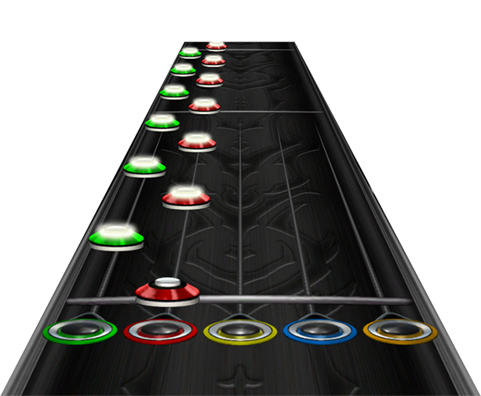
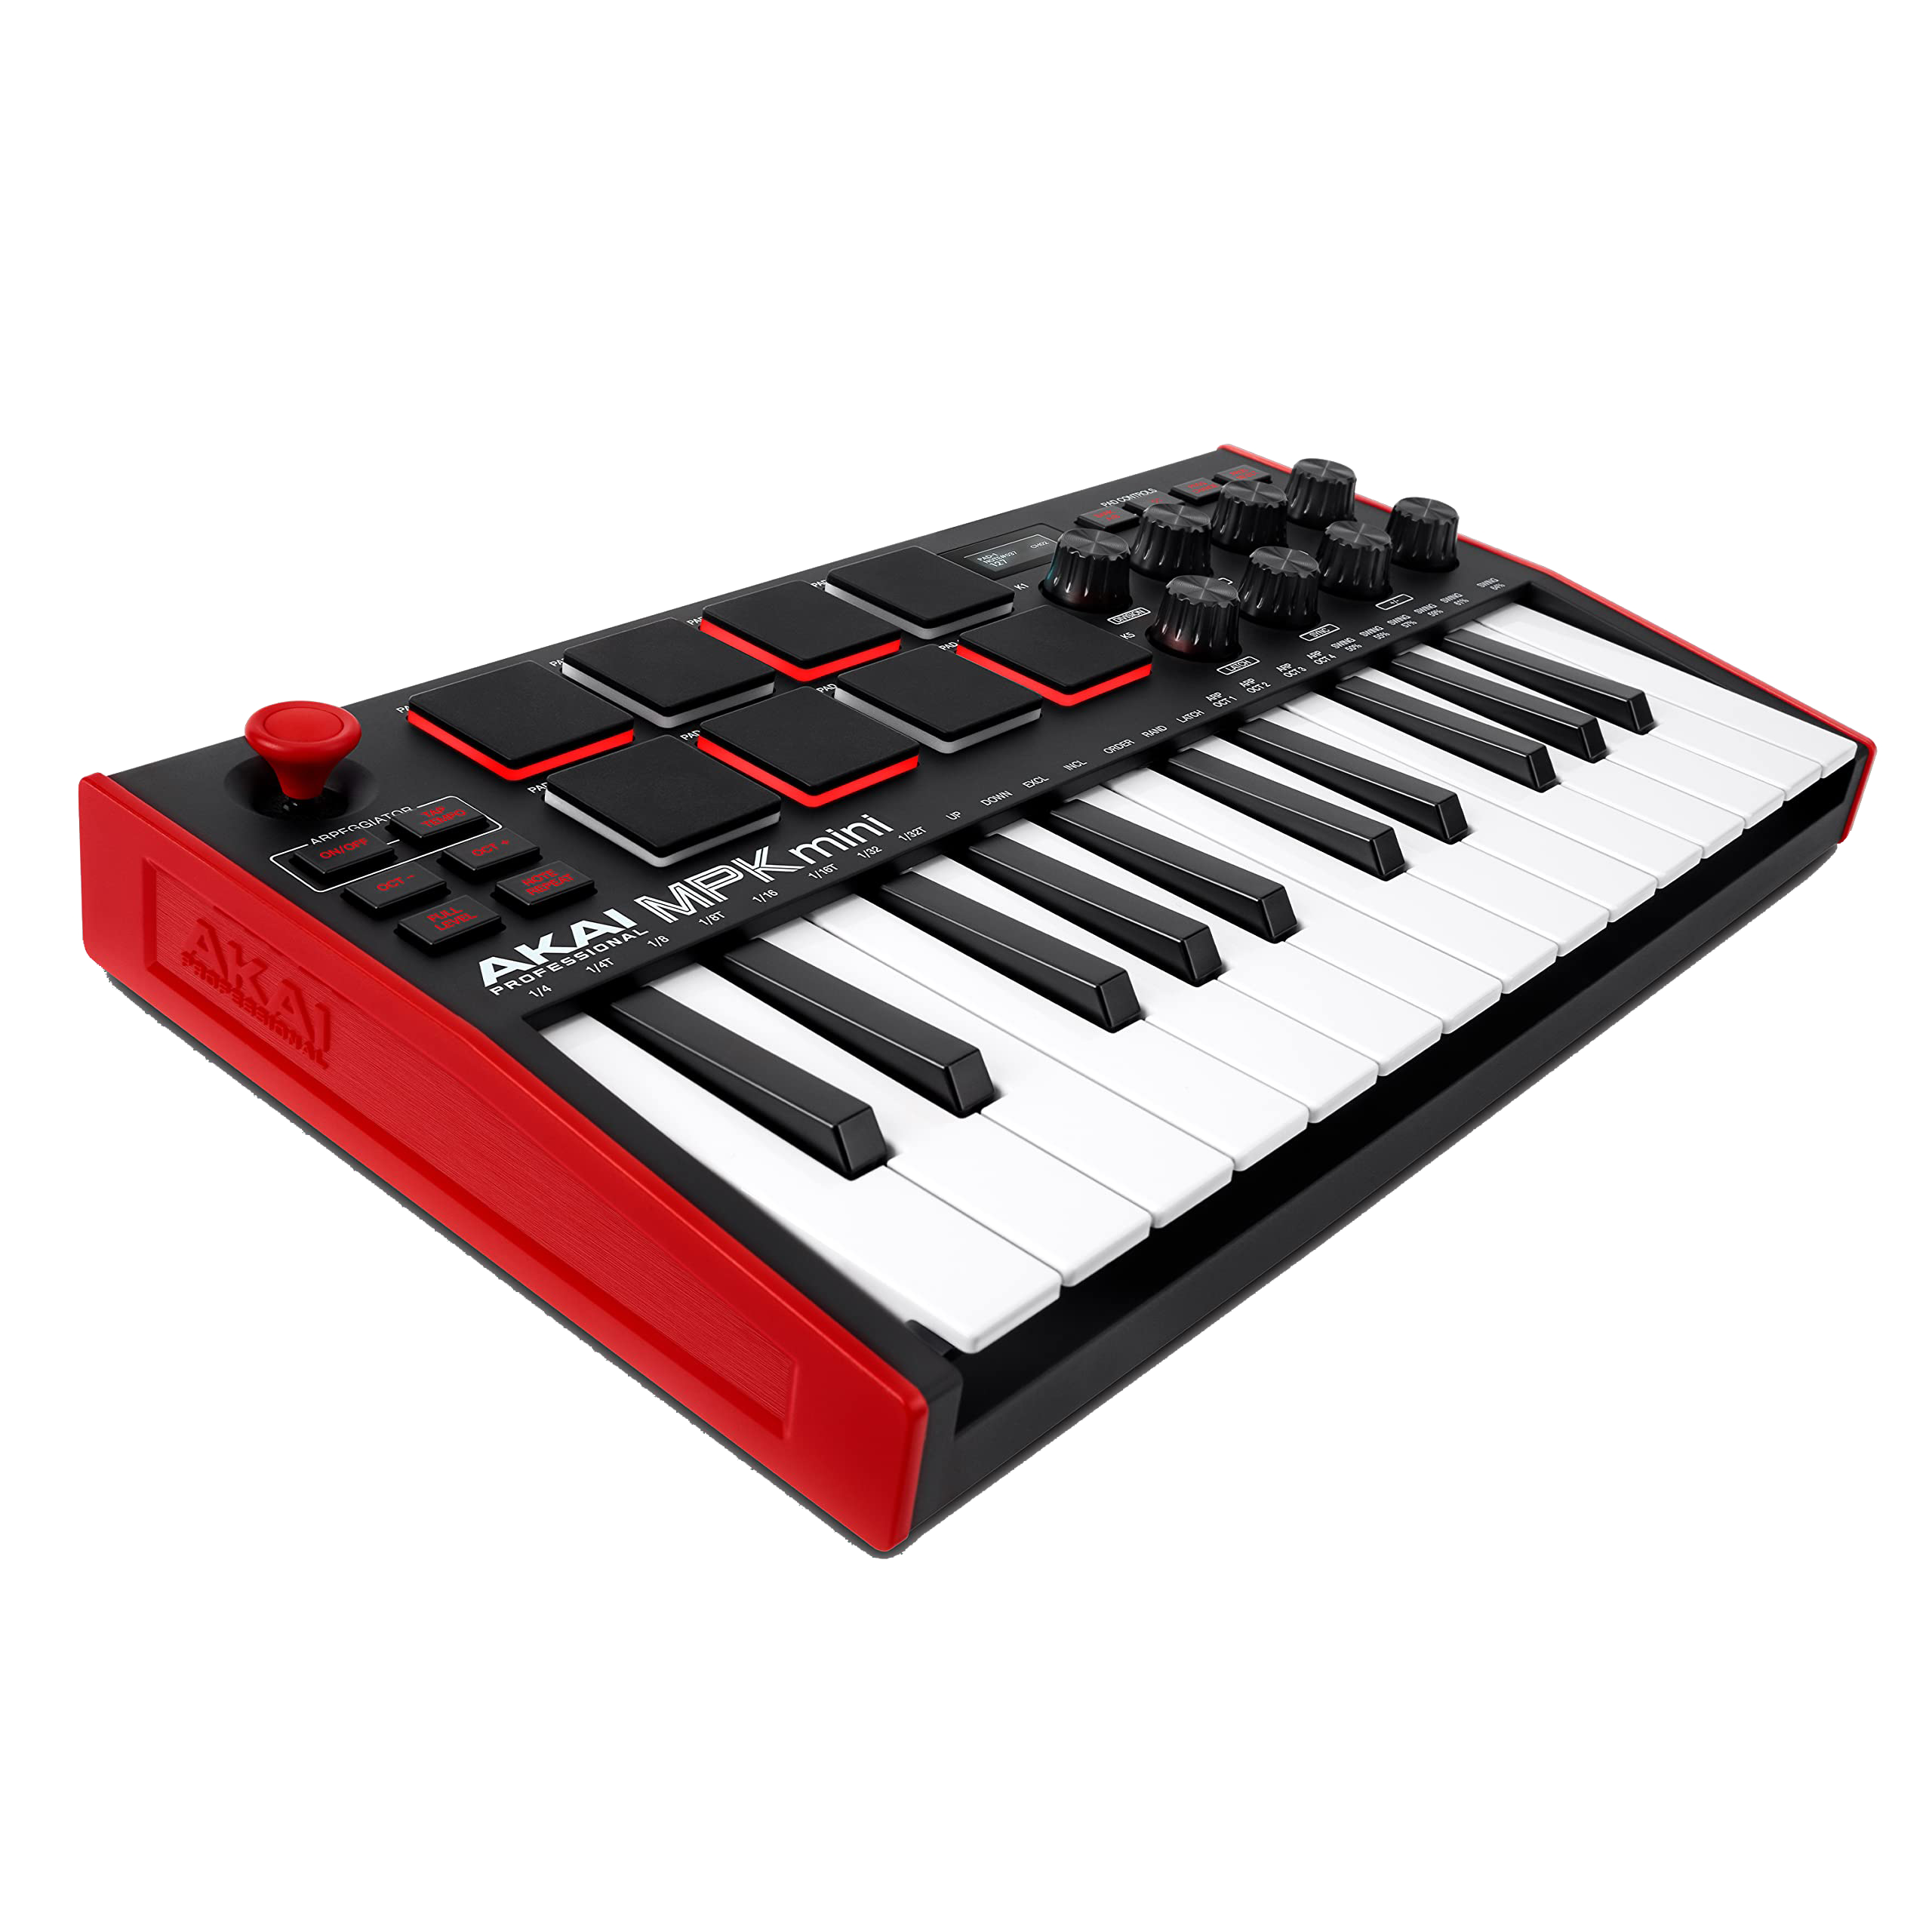
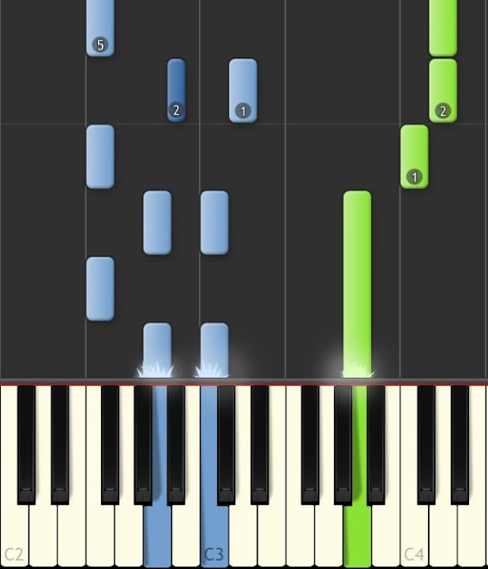
Overview
Midi (Parsing, Input, Writing)
Gameplay = Guitar Hero + Midi Keyboard
+
=

Slide 3
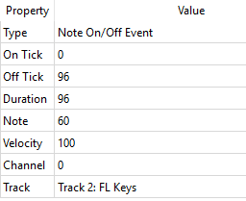
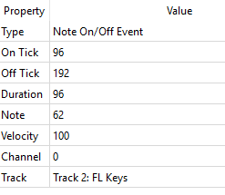
Midi Parser
First Note
Second Note

Slide 4
Midi Parser
Note On chunk
Note On chunk
delta
delta
Byte Status:
Note On
Byte Status:
Note Off
Note Value:
60 = C5
Note Value:
60 = C5
Note Velocity:
64 = 100 (full)
Note Velocity:
40 = 64 (middle)

Slide 5
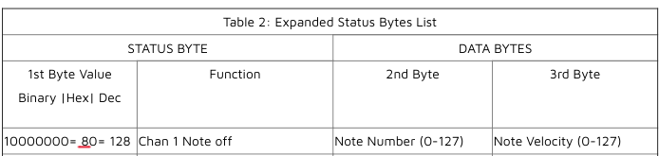

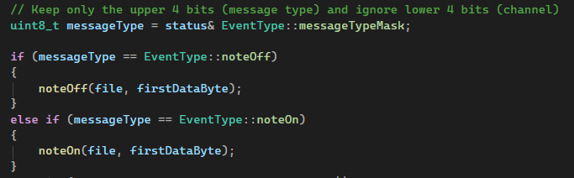
Status Byte

Slide 6
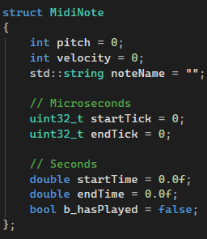
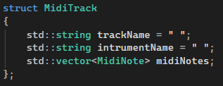
Storing parsed Midi Data
Midi Note
Midi Track

Slide 7
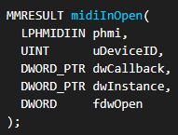
Midi Input Callback function
Windows Multimedia API (winmm.dll)
Opening connection for Midi Input

Slide 8
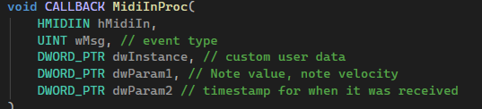
Midi Input Callback function
Midi Callback function

Slide 9
To do
Writing to Midi file – Similar to Parsing but in reverse.
(For users to upload to the server and download)
Statistics.
Piano Roll.
Latency adjustment option.
Bug fixes.

